Slide 1

TEAM 15
SMART WATER HEATER

Slide 2

ROLE OF TEAM MEMBERS
•All the team members have actively participated in all the team meets.
•Subhayan: Have done the assembling of the hardware components.
•Komal: Working on the presentation part (ppt) and the research part on how to build our model.
•Toshanhame: Ordered the components and helping with the programming part.
•Swabhiman: Programming and assisting on how to assemble the components.
•Apart from these, each one has devoted their time in researching on how to make this model and given their valuable inputs time to time.
This Photo by Unknown author is licensed under CC BY-SA-NC.

Slide 3

INTRODUCTION
•Water heaters or geysers have become a common household appliance in India. Due to the rapid advancements in science and technology, the Indian markets are filled with various types of water heaters and geysers ranging from the prices of 1500-25,000 rupees depending on the different functionalities and features. The water heaters that the middle-class use is of the range of 1500-8000 rupees which doesn’t come with any sort of temperature control facility. So, we have come up with a solution that will bridge this gap. Our water heater comes with smart temperature-controlled facility in a cheap and affordable price. Sometimes it is very important to keep an eye on a heater which is directly energised by the AC mains, due to human mistakes anything can happen on a running heater for long time, hence it is very essential to keep it in the control by any system or man power, so our model controls the on/off system of the water heater using the help of sensors and regulators and protects the user from any potential hazards of overheating.

Slide 4

PROBLEMS AND SOLUTIONS
•Problem: Unavailability of cheap and affordable smart temperature-controlled water heaters for the Indian markets. Along with this, problem of overheating is also resolved by our model.
•Solution: Our project is made out of simple components available in the markets which include Arduino Uno, simple heating immersion rod, 5V relay module, Voltage Regulator, DS18B20 Temperature sensor, Nokia LCD screen, regular switches and wires and an electric socket. Arduino Uno is fed with the programming which will get sort of feedback as the voltage output from the temperature sensor and provide signals to the relay which will off the power supply in the socket which will lead to the switching off of the heater after the desired temperature is reached.
As a result of this, the power supplied to the heater is turned off as it reaches the desired cut-off temperature fixed by the user using the rotary encoder.

Slide 5
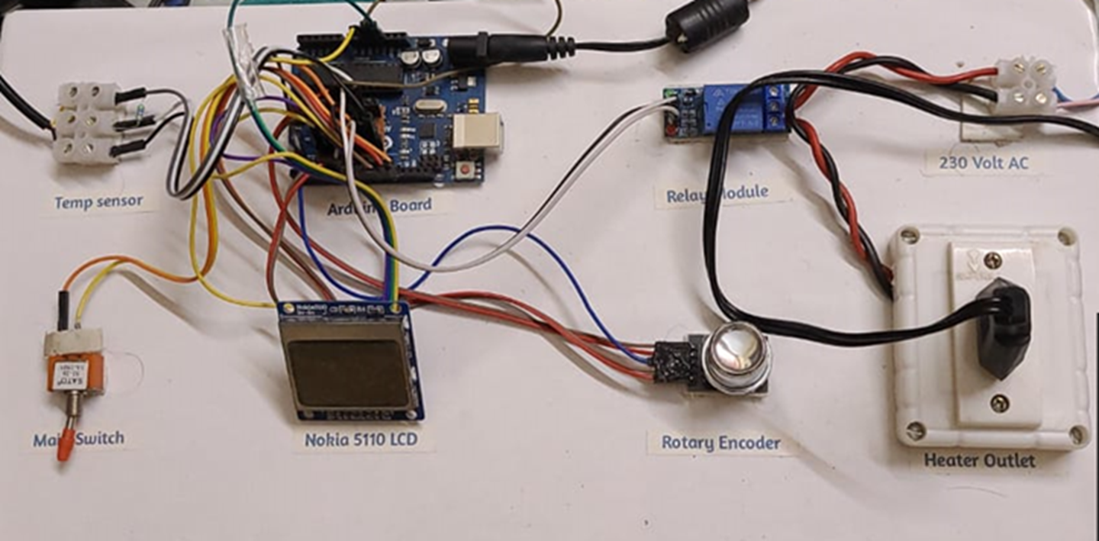
THE MODEL

Slide 6
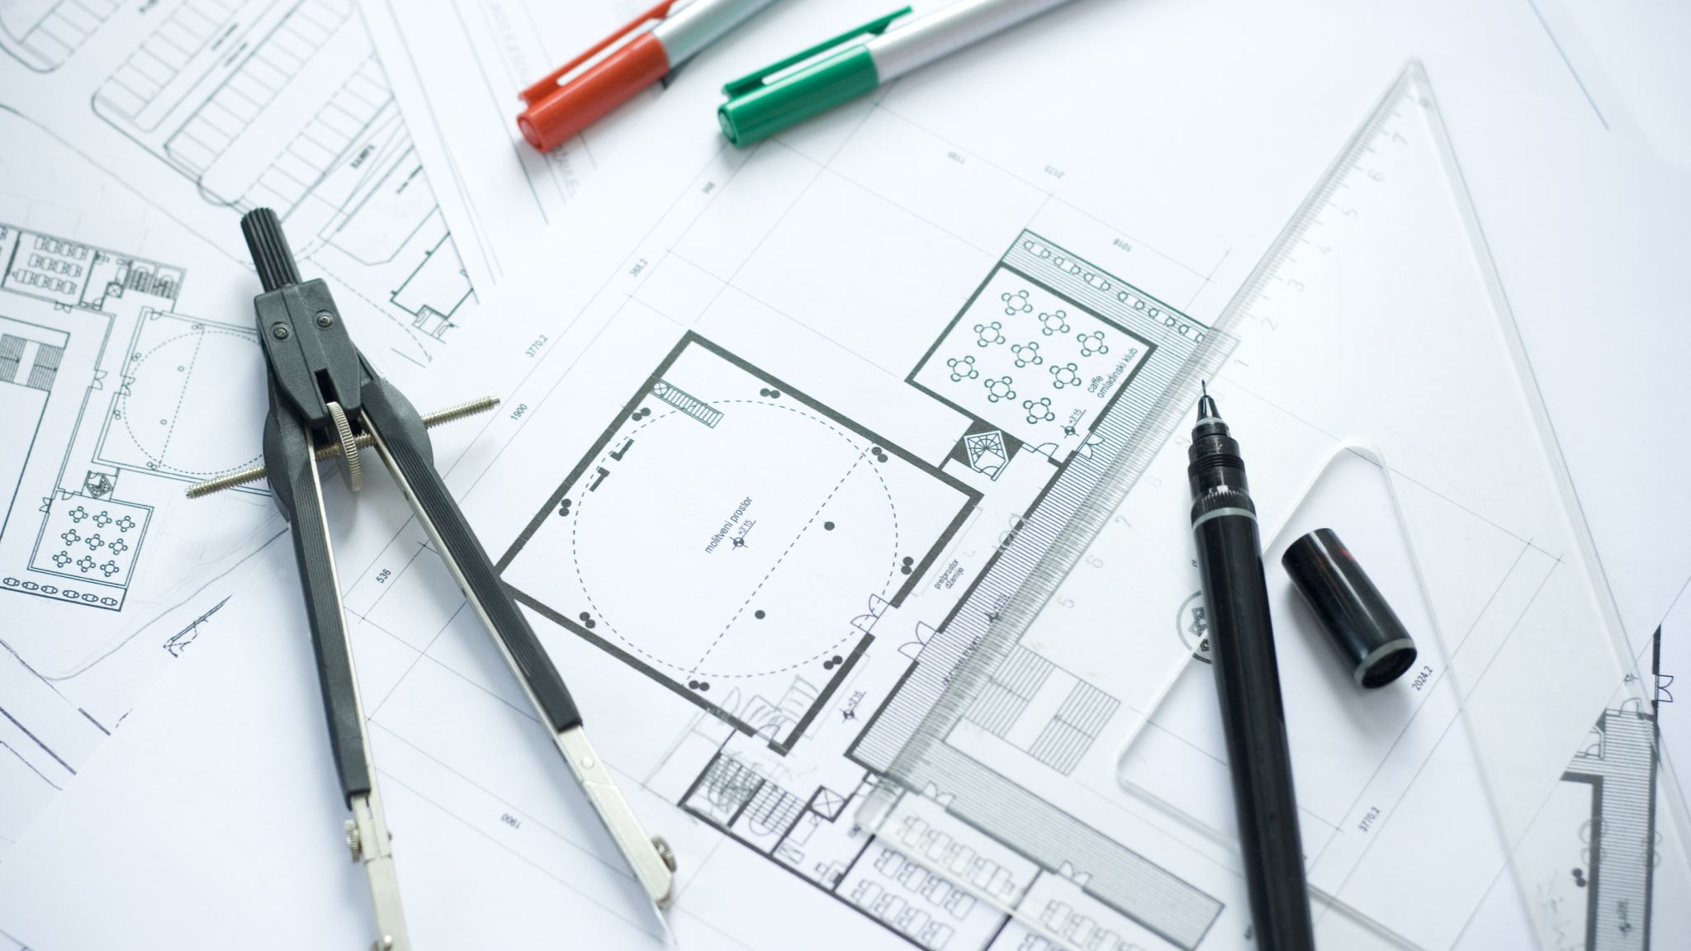
OUR MODEL OVERVIEW WORKING
As we switch the model ON( that is powering on the Arduino and the 230 V socket) and press on the main switch, the LCD displays the text saying “ Auto cut water heater”. Then we require rotate the rotary encoder and set the desired temperature we want by rotating the knob and as we are able to see the temperature on display we press the switch of knob. As soon as, we switch it on the display reflects the current temperature of the water in the container which is fed in by the temperature sensor used.

Slide 7
WORKING CONT...
The water heater that we built has a temperature sensor (DS18B20), which senses the temperature of the water, it is dipped in. And this leads to energizing of the relay module which was previously in NO mode (Normally open) switches to NC mode (Normal closed) and the 230V socket gets the power and heater starting heating the water as the circuit is closed. Slowly the water gets heated, and the temperature gets changed and which gets displayed on the LCD screen. When the required temperature is reached the Arduino terminates the supply of current to relay module and it gets back to NO mode and heater gets turned off.
This method can again be repeated when we require to set any other temperature.

Slide 8

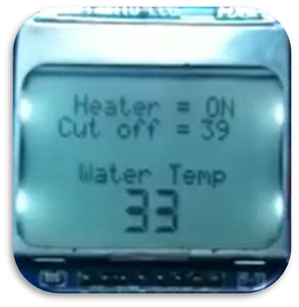
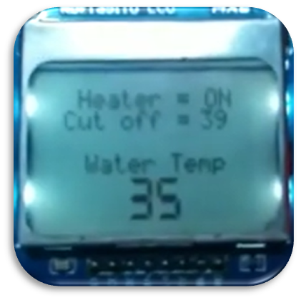
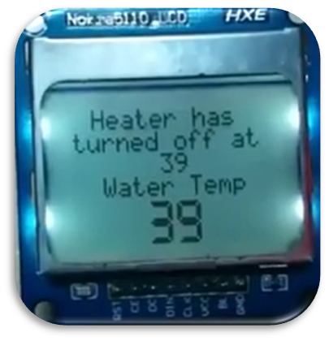
LCD SCREEN DISPLAYING RESULTS
Initial temperature reading = 33C
Heater status = ON
After 3 minutes
Heater status = ON
After reaching the desired temperature
Heater status = OFF

Slide 9

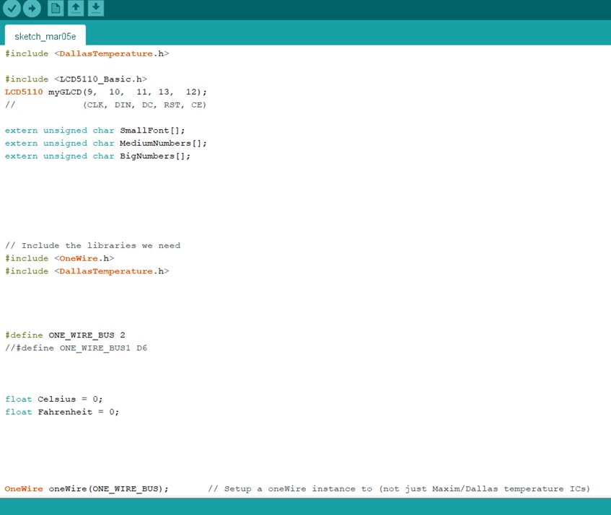
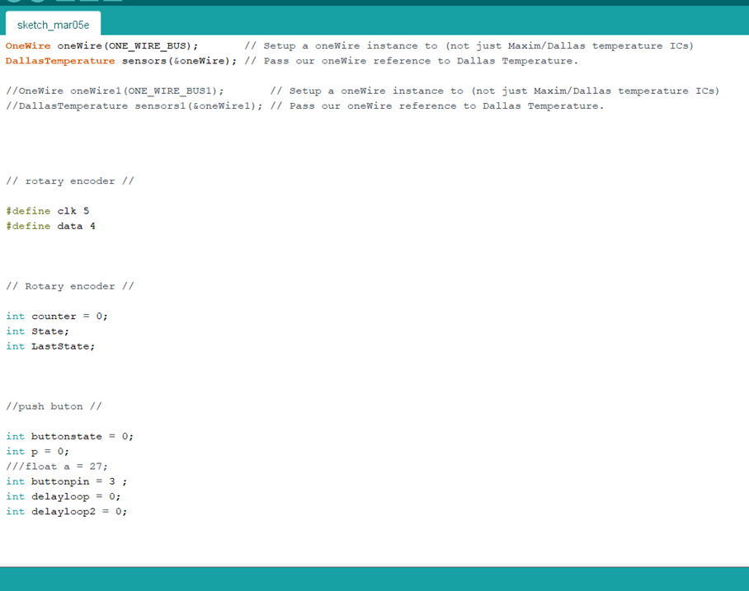
CODE 1

Slide 10

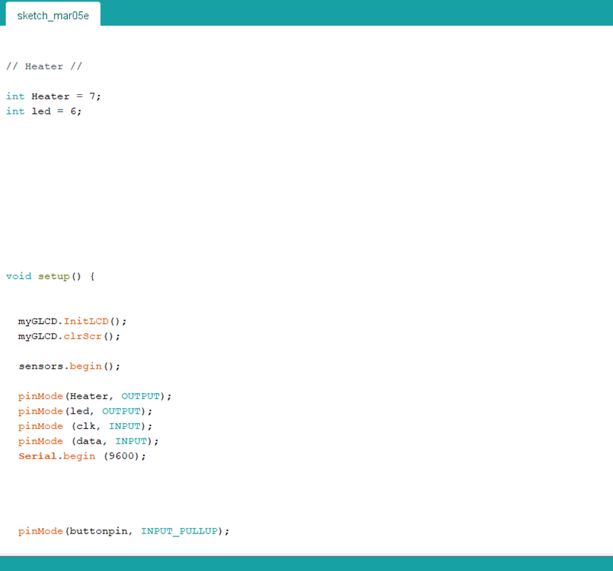
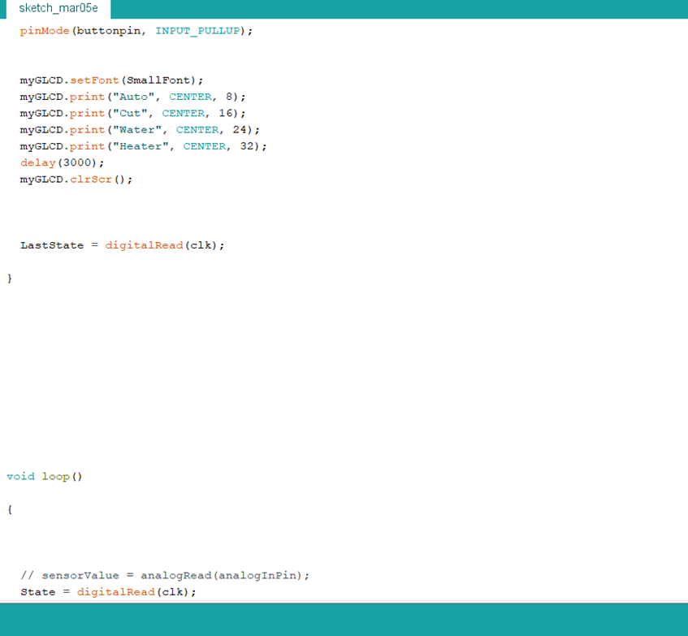
CODE 2

Slide 11
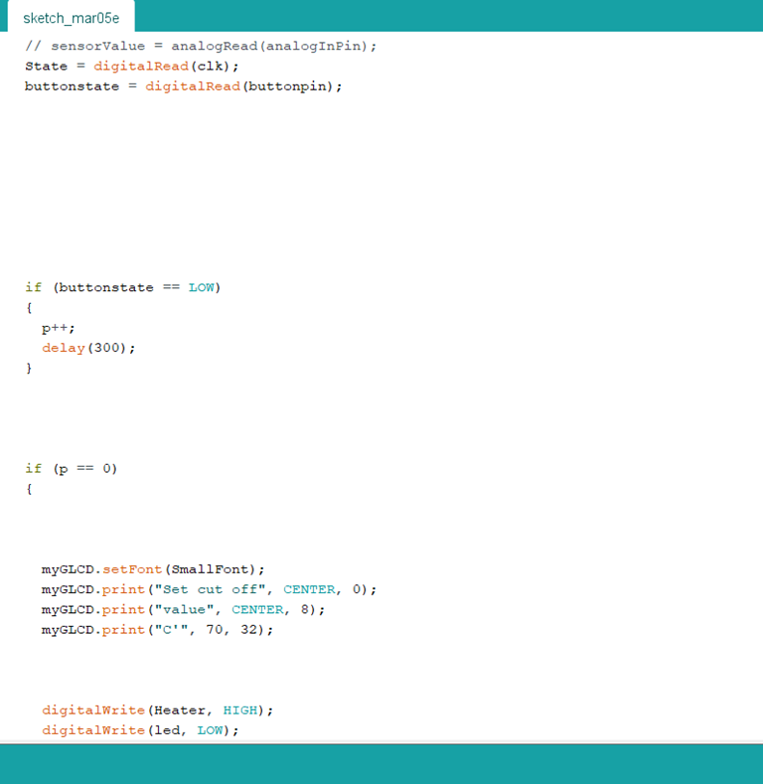
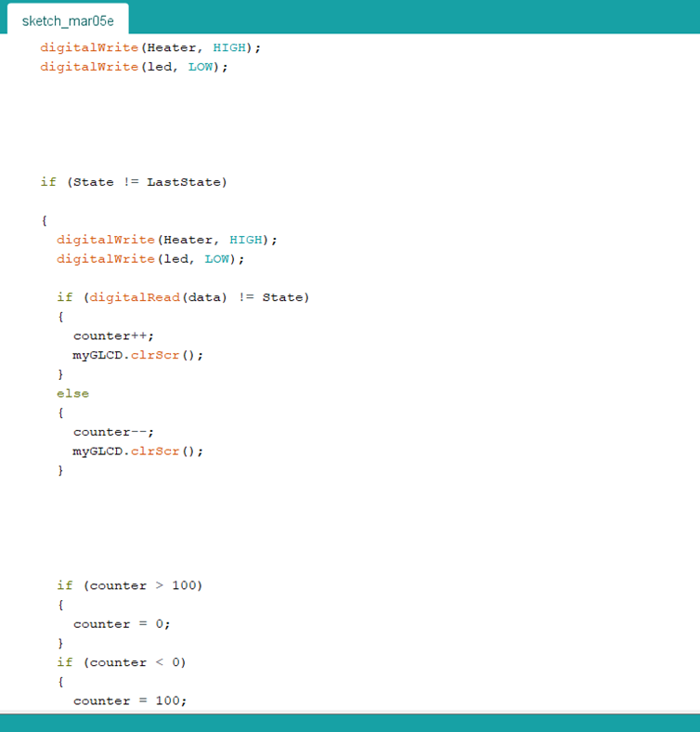
CODE 3

Slide 12
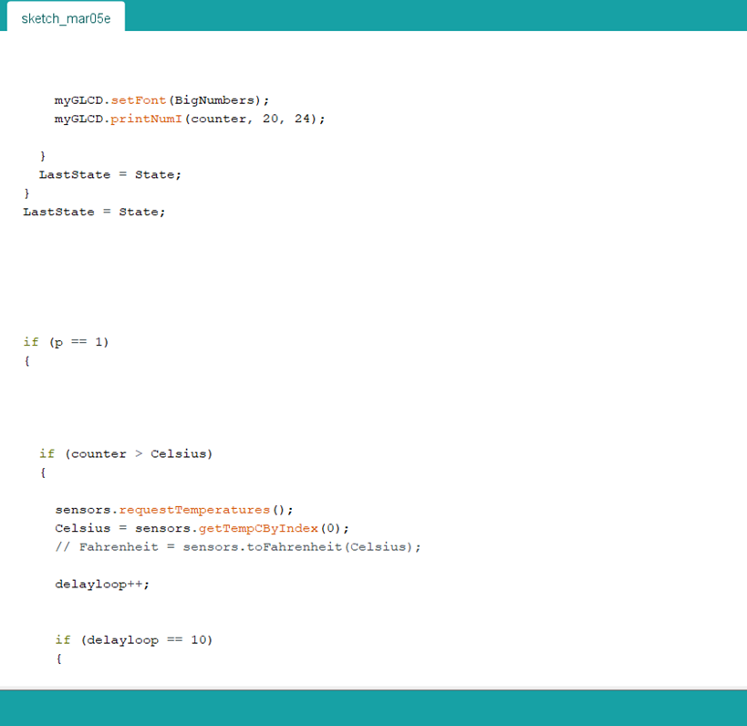
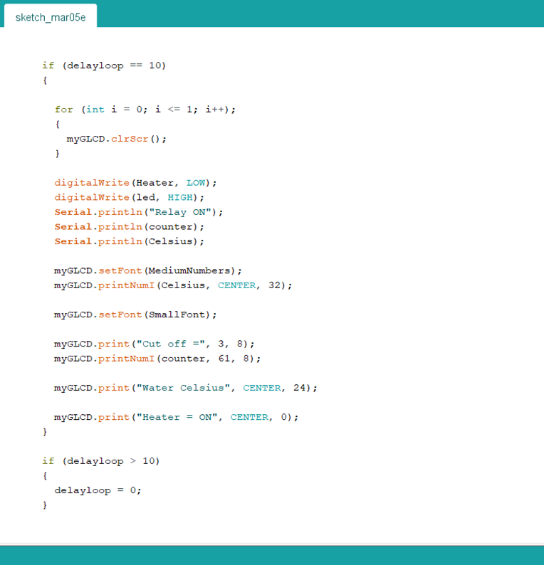
CODE 4

Slide 13
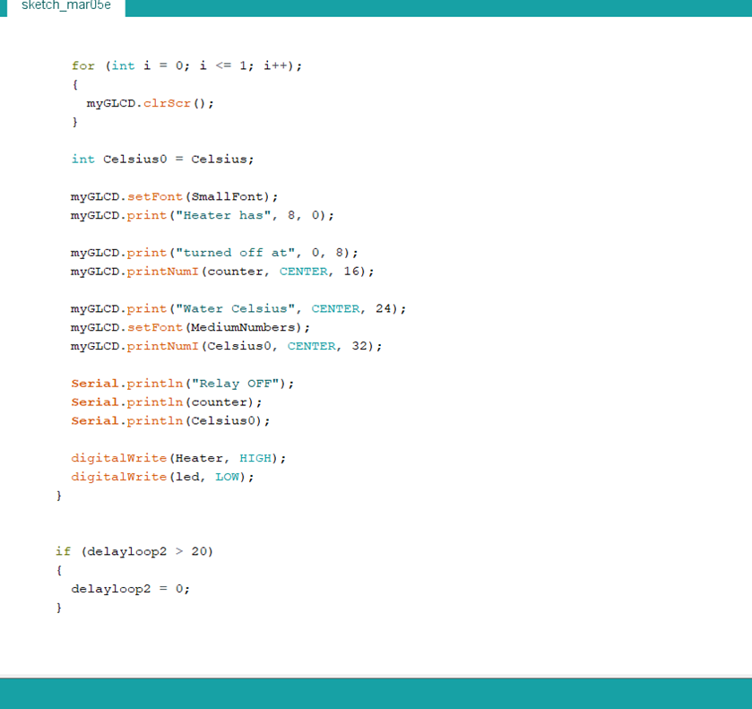
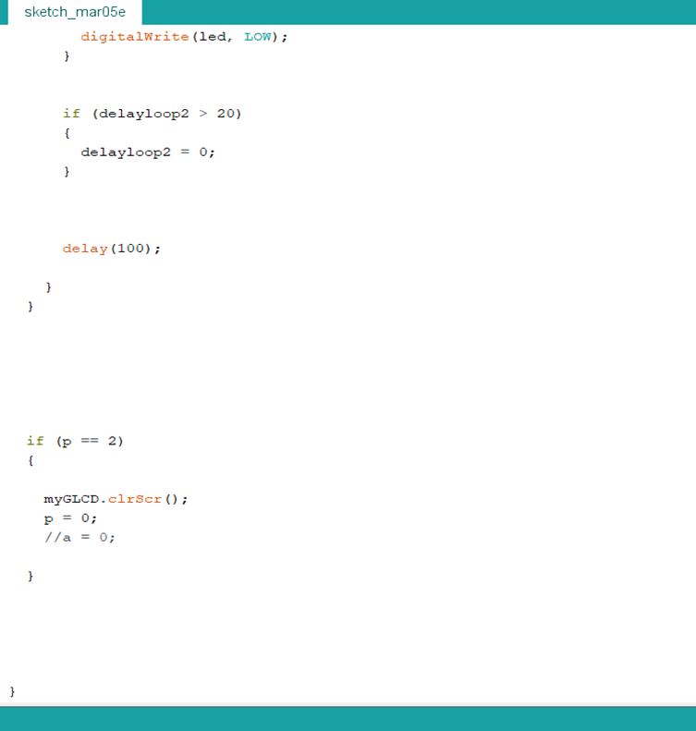
CODE 5

Slide 14

LIMITATIONS OF OUR MODEL
Our model is a prototype model which has the minimalistic and easily available components and could be scaled up for further applications in the houses and areas that require water heating facilities. The model will require some sort of casing/design for the body of water heater before consumer use which will lead to an increment in price. But this increment will still be within the limits that is considered to be affordable compared to the costly options available in the market.

Slide 15
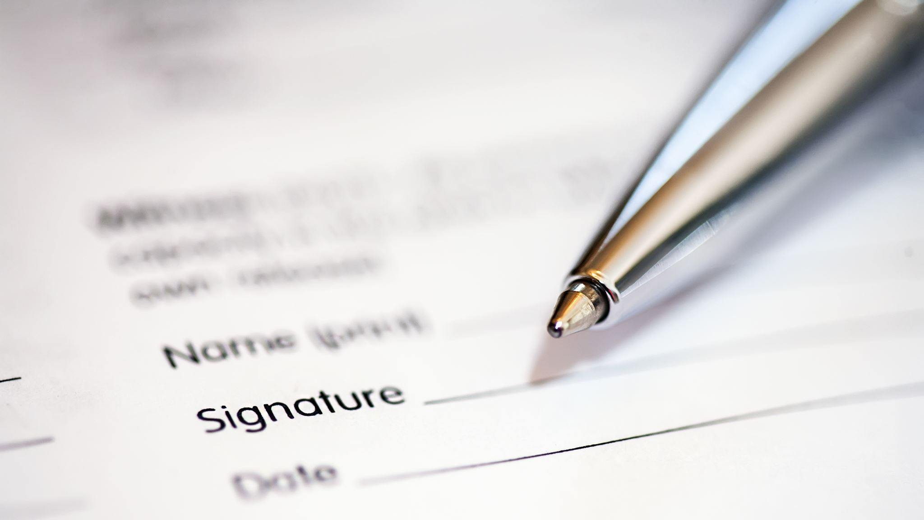
CONCLUSION
This model can help the middle-class Indian to have an experience of smart water heating in an affordable price and overcome the potential hazards of overheating which is faced in cases of simple water heaters. This will surely uplift the standard of living of the middle-class household.

